Slide 1

Virtualization and Cloud Computing
104KM: Enterprise Information Systems
Nandor Verba - 2018

Slide 2
Learning Objectives
Virtualization of Storage and Systems
Cloud Computing and its characteristics
Deeper understanding through Use Cases The main purpose of this lecture is to give you an overview of Cloud Computing and its role in business and Informatics.

Slide 3

Why use the Cloud?
Applications for the 2012 London Olympics tickets had to be extended after high demand caused problems with the official Ticketmaster website.
Ticketmaster extended the deadline for applications until 1am following the incident.
At one point a processing error caused an estimated 700 customers to be double-charged for their tickets.
And, just two years later, the Glasgow 2014 Commonwealth Games was subject to similar issues.
Graysen Christoper and Matthew Finnegan - computerworlduk.com, June 8, 2016

Slide 4

Why use the Cloud?
May 2009, India
Indian, with 1 billion+ population, goes to the jumbo general election. The election commission unveiled a brand new website that is well prepared to handle 80.64 billion hits in 8 hours (2,800 hits/second).
On the election result day media reported:
300,000 hits/second make Election Commission website crash.
This per second hit rate means 8.64 trillion hits in 8 hours.

Slide 5
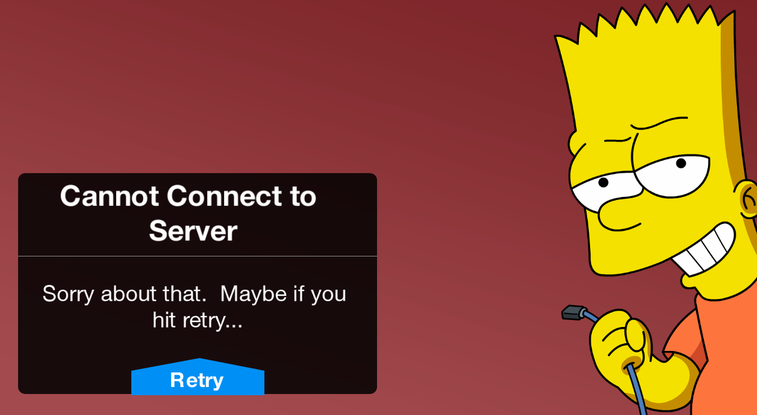
Why use the Cloud?
Peaks and unexpected demands are problematic.
First of all, they affect your profit because you become inoperative.
Second, they make you look bad with your clients, which may affect your profit even more.
If you are unavailable, users will change to competitors.

Slide 6

Why use the Cloud?
Start-ups and New Products:
Start small and fast
Low initial costs
Think big, scale up
Flexibility, test and add features and platforms
Focus on product and features rather than system administrator tasks and security

Slide 7
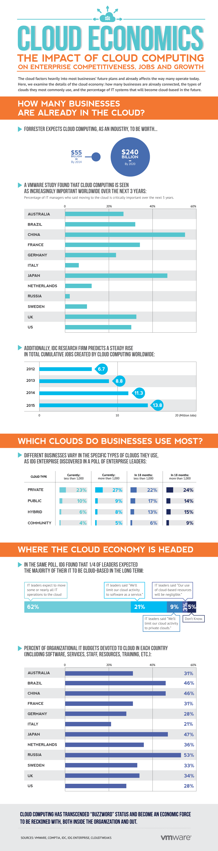
Why should I care ?

Slide 8
Why should I care ?

Slide 9
Why should I care ?

Slide 10
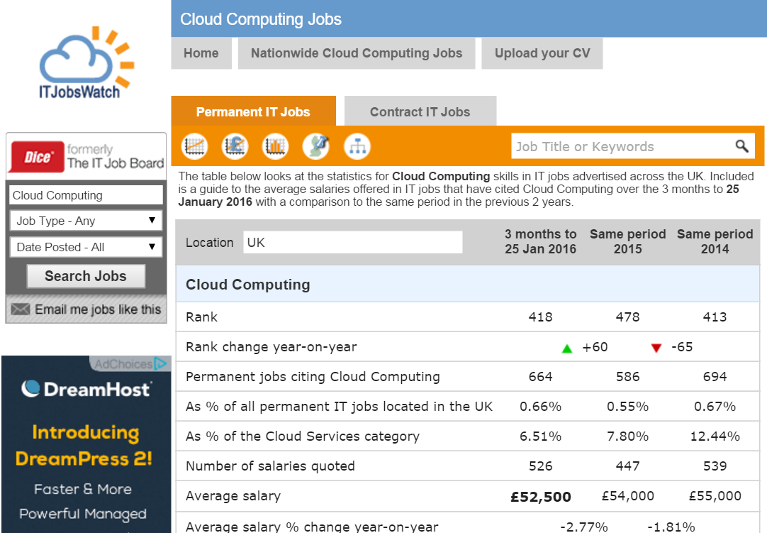
Future in the Cloud

Slide 11
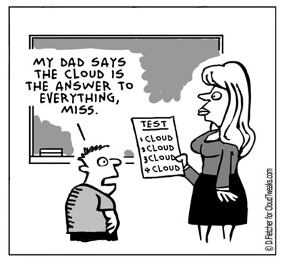
What is Cloud Computing?
Cloud Optimist:

Slide 12
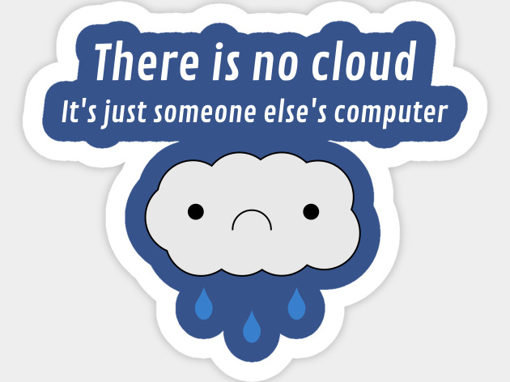
What is Cloud Computing?
Cloud Pessimist:

Slide 13
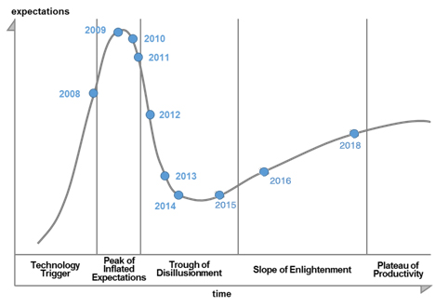
What is Cloud Computing?
Gartner Hype Cycle:

Slide 14
What is Cloud Computing?
According to NIST (National Institute of Standards and Technology, US):
Cloud computing is a model for enabling convenient, on-demand network access to a shared pool of configurable computing resources (e.g., networks, servers, storage, applications, and services) that can be rapidly provisioned and released with minimal management effort or service provider interaction.

Slide 15

What is Cloud Computing?
Cloud-computing fees for businesses are typically subscription-based.
The vendors usually charge you on a month-to-month or annual basis.
If your demand increases, simply ask your cloud provider to add more infrastructure. Pay-as-you-go ensures you’ll never pay anything extra.
Many of these solutions can work for a business with five employees or 5,000.
Cloud-based service is nimble because it grows as your business grows.

Slide 16
What is Cloud Computing?
Characteristics:
Ubiquitous access ( access from anywhere on the web )
Abstraction( CPU, Memory, Storage, Networking, Services )
Pooling of resources ( shared resources )
Rapid elasticity ( scaling )
Measured service usage ( billing )
“In addition to removing server management from the equation, shifting to the cloud can reduce expenses and increase productivity in connection with software”.
Elsa Wenzel. PC World

Slide 17

Benefits of Cloud Computing
Scalable resources (dynamism)
Pay as you go
Abstraction
Resource sharing → Cost reduction
Broad access through different devices (as long as you have Internet connection!)

Slide 18

Disadvantages of Cloud Computing
Security
You have no control over where your data is stored in a public cloud.
You hope that the provider does not use the data for its own purposes.
One size fits all
Cloud computing usually offers generic solutions with some common choices (infrastructure, OS, development environments, apps, etc.)
Quality of Service (QoS)
Your business runs on other organization’s IT infrastructure and is dependant on it.

Slide 19
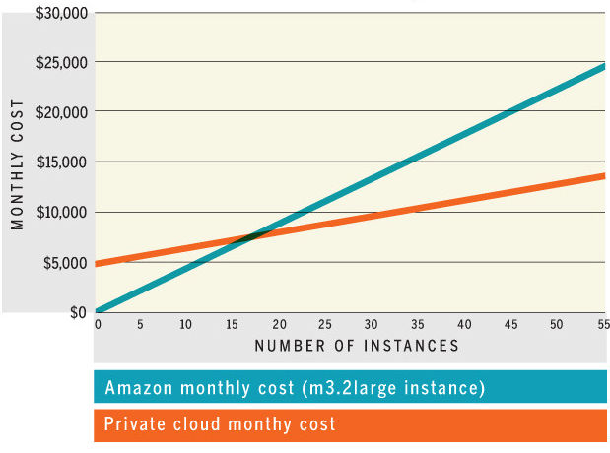
Costs of Cloud Computing
Reduction, to a certain level of computing requirements**
Low initial costs of deployment
Usually a hybrid model is more profitable. Using the private cloud for usual demand, public cloud for peaks.
Actual inflection point of where each deployment type is most cost effective is hard to determine.
Private cloud setups will have added costs of maintenance and personnel
**Weinman, J. (2011). Cloudonomics: a rigorous approach to cloud benefit quantification. J. Software Technol, 14(4), 10-18.

Slide 20
Cloud Computing Types (Abstraction)
Based on the level of abstraction:
IAAS – Infrastructure as a Service – provides infrastructure (servers, storage, etc.) as a service to users
PAAS – Platform as a Service – provides the same as IAAS but can also include the runtime environment that allows you to deploy your own applications
SAAS – Software as a Service – provides a hosted application that fulfills a function for the user. You simply use and configure you application.

Slide 21
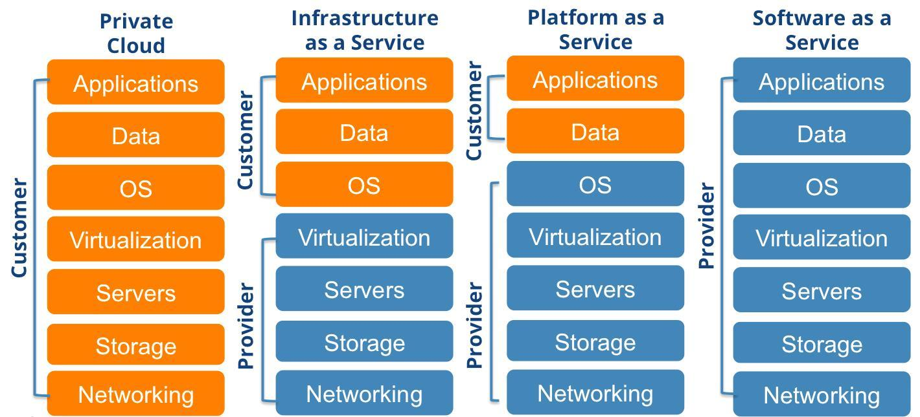
Infrastructure as a Service
+ The customer gets raw configurable resources like servers and storage. + Full control over application environment and deployment. + It can includes networking, firewalls and security based of Service Level Agreement (SLA). + It can also include clustering, load balancing, and storage resilience. - The customer has to configure and manage some of the IT infrastructure, the application environment and the storage.

Slide 22
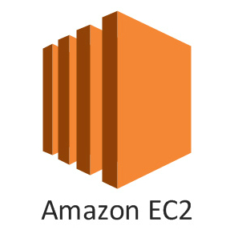
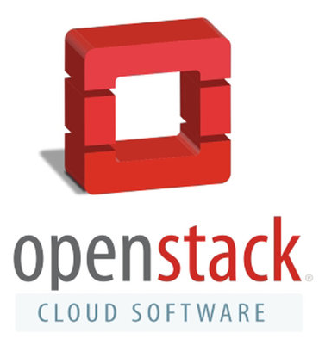
Infrastructure as a Service
Examples:
Amazon EC2 is a good example of an IaaS. In Amazon EC2 (Elastic Compute Cloud) your application will be executed on a virtual computer ( also known as an instance). You have your choice of virtual computer, meaning that you can select a configuration of CPU, memory and storage that is optimal for your application. Some OS settings can also be adjusted
Openstack is a the most commonly used example of private IaaS deployment. Openstack and its components can be used to set up you own datacentre with redundancy and all the functionality a public cloud has. It is a open source project with main backers such as IBM, Intel, China Telecom, Cisco and others.

Slide 23
Platform as a Service
+ The customer gets everything they would get with an IaaS setup.
+ They also get a managed Platform or Application environment they can deploy their applications to.
+ This can include text editing, version management, compiling and testing
- The user is locked in the environment the cloud provider offers.
- Less control and visibility over the whole deployment and components

Slide 24
Infrastructure as a Service
Examples:
Google App Engine is an example. It offers managed development environments for Python, Java, PhP, and Go. The customer pays based on the number of instances needed and the number of hours that the application has been running.
CloudFoundry is an open source example of a PaaS. It offers an industry standard platform for Java, Node.js, Ruby, Go, Python etc. It offers both Container and Application runtime capabilities with lifecycle management, networking and monitoring.

Slide 25
Software as a Service
+ Every aspect of the application is handled by the provider, that takes care of automatic updates, security and maintenance.
+ No need to purchase software and licenses which may be underutilized.
+ Pricing is on a per-use basis
- Little control over the service with only limited customizations possible.

Slide 26
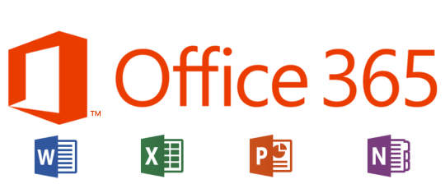
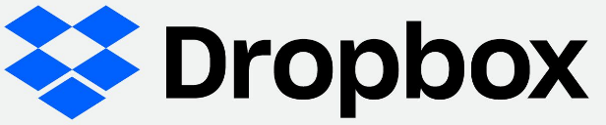
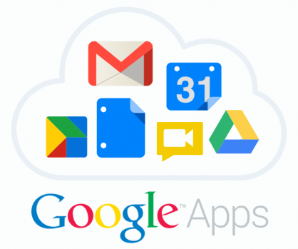
Software as a Service
Examples:
Microsoft Office 365 provides Mail, and Office Suit capabilities on and off site to companies such as Coventry University.
Dropbox provides storage, versioning and sharing facilities for documents, videos, photos and files.
Google Apps offers Mail, Documents, Storage, Calendar and many more functionalities for companies

Slide 27
Cloud Computing Types (Abstraction)

Slide 28
Anything as a Service – XaaS
INaaS – Information as a service – Provides information or analysis on an individual or business. Pricing usually on a per-use basis.
BPaaS – Business process as a service – Fulfills a business function or replaces a process. Combines Business process outsourcing (BPO) with SaaS
DaaS – Desktop as a Service – Provides virtual desktop services to users
NaaS – Networking as a Service – Provides networking capabilities
FWaaS – Firewall as a Service – Provides firewall services to users
MaaS – Metal as a Service – Provides server provisioning services to users
DBaaS – Database as a Service – Provides access to a database platform
XaaS – Everything as a Service – New trend in computing that acknowledges that certain available services are compound services and provide a hybrid of IaaS, PaaS and SaaS functionalities. This trend also attempts to provide every component of Information Technology as a Service ( Above we have a number of examples of this).

Slide 29
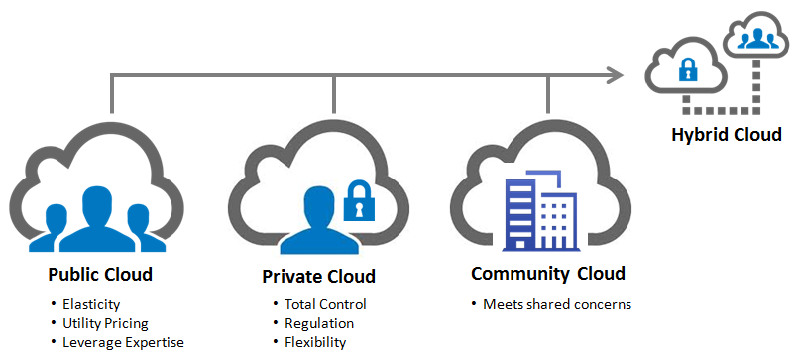
Cloud Computing Types (Deployment)
Based on the deployment model:

Slide 30
Public Cloud
Public Clouds are the most commonly know type. It is available through the internet to the consumers through a Pay-as-you-go service.
+ They provide an elastic, cost-effective means to deploy solutions.
- Platform lock in and end of month Bill Shock
- Security is a major concern for public clouds.
"Cloud computing is often far more secure than traditional computing, because companies like Google and Amazon can attract and retain cyber-security personnel of a higher quality than many governmental agencies."
Vivek Kundra, former federal CIO of the US

Slide 31
Private Cloud
Private Clouds offer many of the benefits that a public cloud provides. The difference is that the company owns the infrastructure on which it is built. Typically hosted over the company WAN.
+ Increased security and control.
+ Fewer restrictions and legal requirements
- Scalability of the cloud is limited to the size of the organizations datacentre
- Due to the relatively small size of a private cloud redundancy and reliability could be affected.

Slide 32
Community Cloud
Community Cloud is a broader version of the private cloud. It is controlled and used by a group of organizations having shared resources usually through the internet.
+ They provide a possible solution to the scaling and reliability problem of the private cloud through sharing of capabilities and resources among peers.
+ Can be limited to region or country to meet legal or logistical requirements
- Are less secure than the private cloud

Slide 33
Hybrid Cloud
Hybrid Clouds are some form of combinations of the other three cloud types. It typically outsources non-business-critical information and processing to the public cloud keeping everything else in the other two.
+ Solves the problem with scalability and reliability allowing processes to be offloaded when needed.
- Managing migration can be difficult.
- A highly divided system could cause update and versioning difficulties.

Slide 34
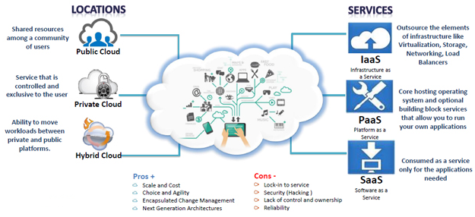
Cloud Computing Types -Summary

Slide 35

Use Case – 3d Printing Company
A 3d printing company from Bristol is developing its own product that can optimize 3D prints and validate whether they could print using different materials. They also plan to use this platform to promote their printing services and host user builds that they can showcase.
The company has its own server in-house but after recent attention from the media and appearance in the news they are seeing some peaks on their servers.
Propose a solution for their problem!

Slide 36
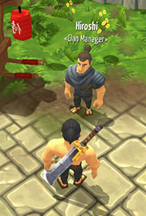
Use Case – MMO
A small gaming company wants to release its first Massively multiplayer online game. They need to be able to quickly change version of the game as bugs are fixed and features added.
They have a highly dynamic team of developers from varying parts of the globe and managing changes and compilation times is crucial.
Propose a solution for their problem!

Slide 37
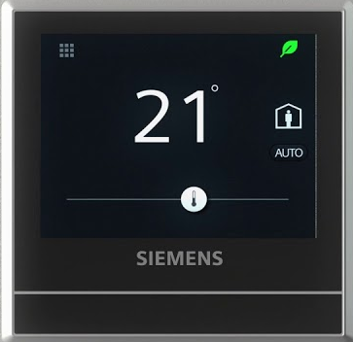
Use Case – Siemens IoT
Siemens is developing a new line of Artificial Intelligence enabled home sensing devices. These devices collect data from the home and send the data to their cloud for analysis.
They have dedicated datacenters in Germany with custom builds designed to process and store the sensor data.
Despite this they are concerned with reliability and delay issues for satisfying the needs of customers worldwide.
Propose a solution for their problem!

Slide 38
Further Reading and Links
Ruparelia, Nayan B.. Cloud Computing, MIT Press, 2016. ProQuest Ebook Central, http://ebookcentral.proquest.com/lib/coventry/detail.action?docID=4527741 Online courses:
Cloud Computing Concepts
Introduction to Cloud Computing

Slide 39
Further Reading and Links
Changes to computer thinking - Stephen Fry
https://www.youtube.com/watch?time_continue=3&v=J9LK6EtxzgM
What is Cloud Computing ? https://www.youtube.com/watch?v=ae_DKNwK_ms

Slide 40
Types of Cloud Computing
Research about the following products and make an educated guess on the type of cloud computing service (IaaS, PaaS, SaaS) that they offer. Give reasons for your choice.
Google App Engine
Salesforce.com
Heroku
Cloud9
HootSuite
Amazon EC2
OpenShift
Gmail
Dropbox
Microsoft Azure
Cloudera
Steam

Slide 41
Types of Cloud Computing
Google App Engine → PaaS, for developers (Python, Java, Php, Go)
Salesforce.com → SaaS for the CRM solution
Heroku → PaaS, for developers (JS, Ruby, Java, PhP, Python, Go, Scala, Clojure)
Cloud9 → PaaS, for developers (HTML5, Node.js, Meteor, Php, Python, Django, Ruby, C++, Wordpress, Ruby)
HootSuite → SaaS, managing your social media

Slide 42
Types of Cloud Computing
Amazon EC2 → IaaS, create and manage instances
OpenShift → PaaS, for developers (Java, Php, Node.js, Python, Scala, Ruby, Perl, etc.)
Gmail → SaaS, email application
Dropbox → SaaS, storage in the cloud
Microsoft Azure → IaaS and PaaS
Cloudera → PaaS, specializing in Big Data solutions
Steam → SaaS, manage game collection and store

Slide 43
Case Study
Case Study:
You have just started a small game development company. You are at the stage where you have to make an important decision. Do you
Case A - Keep everything ‘in house’.
Buy Hardware required ( Including servers and storage space )
Hire IT experts to manage the hardware.
Hire administrator and data analyst to manage data access, analysis and operation.
Case B - you are an adopter of technology and while Cloud Computing is a relatively new field and is less tested you pick it.
Get the required resources through a resource provider.
Hire and train people who can do more than one thing.
However, you also have to deal with security and compatibility issues.
You also need to deal with costumer concerns and demands.
Which would you pick? Keep in mind that you want to be successful, grow and expand. You also want to make sure you keep your customers in the future and create loyalty to your brand by providing a great AND reliable product. Explain your answer

Slide 44
Quiz
Which of the following are advantages of using Cloud Computing?
a. Abstraction ---
c. Pay as you go ---
b. Complete management of the IT infrastructure Incorrect
d. Computing resources without the need of an Internet connection
The cost of using the public cloud for our computing needs is always lower than that of managing our own cloud/IT infrastructure
False
Match the following types of cloud computing with their definitions
Software as a Service (SaaS)
The customer pays for a scalable end-user software applications that are available on almoust any device
Platform as a Service (PaaS)
The customer pays fora scalable develoment and runtime environment that supoort the software they are deploying
Infrastructure as a Service (IaaS)
The customer pays for scalable raw computational resources which they can configure and set.
A large organization has decided to deploy its applications to a cloud environment for scalability purposes and abstraction. However, the organization has many privacy issues as the data that they plan to host may contain trade secrets, and they are reluctant to share it with others. Which deployment model would you recommend?
a. Community Cloud
b. Public cloud
c. Private cloud -- Correct
d. Hybrid Cloud
IaaS cloud computing is meant for the end user
False

